Slide 1
PROJECT 1
Done By:
Ashwini K
Under Mentor name
Arvind

Slide 2
Problem Statements
Part 1:
There are 20 files with .dat extension. You have to read all the files in to single dataframe.
Dataset
The required dataset for the problem are DAT files
Solution
File path is given by setwd() and all data files are read using read.delim

Slide 3
Source code
Source code with comments are given below:
library(data.table)
library(dplyr)
library(plyr)
setwd("C:\ASHWINI\Personal\ACAD\New folder\DAT File")
allfiles= list.files(path="C:\ASHWINI\Personal\ACAD\New folder\DAT File",pattern="*.dat")
length(allfiles)
for (file in allfiles){
# if the merged dataset doesn't exist, create it
if (!exists("dataset")){
dataset <- read.delim(file, header=TRUE, skip=9 ,sep="\t")
}
# if the merged dataset does exist, append to it
if (exists("dataset")){
temp_dataset <-read.delim(file, header=TRUE, skip=9 ,sep="\t")
dataset<-rbind(dataset, temp_dataset)
rm(temp_dataset)
}
}
dataset
str(dataset)

Slide 4
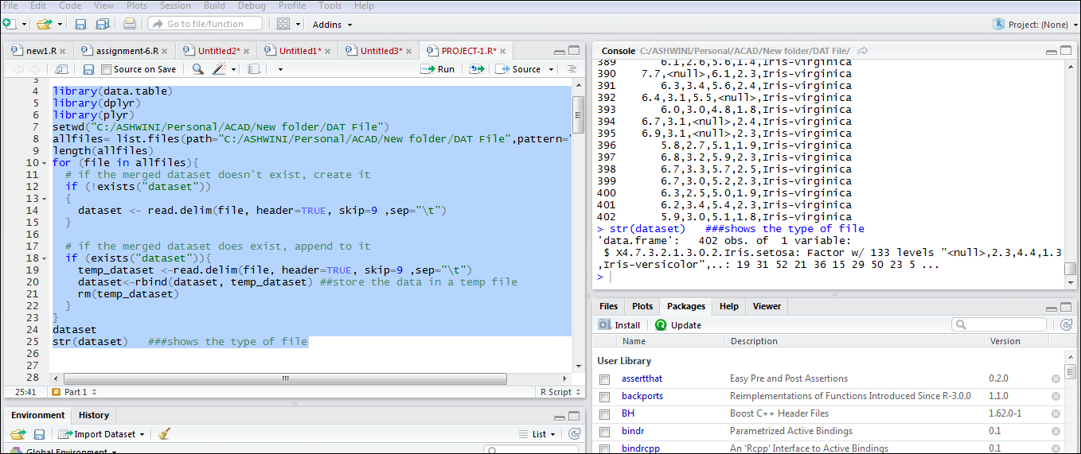
Screenshot for the solution

Slide 5
Part 2:
The data is present in xml format, with file name, iris.xml. Your task is to read the XML data and store it the data frame df.
Dataset
The required dataset for the problem are iris.xml
Solution
Convert the iris.xml file to data frame using xmlToDataFrame()

Slide 6
Source code
Source code with comments are given below:
library(XML)
url<-"C:/All/R language/9 Proj 1 Assignment Session/iris.xml"
dataframe_df <- xmlToDataFrame(url) #converts xml to dataframe
dataframe_df #display data frame df

Slide 7
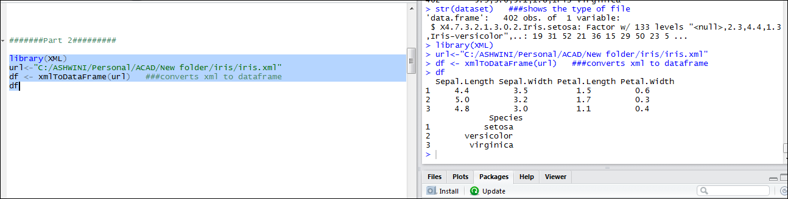
Screenshot for the solution

Slide 8
Part 3:
Convert the iris data into the JSON format and read the data in JSON format and convert
It into dataframe “iris_data”
Dataset
data from Part 2
Solution
Convertions using JSON function

Slide 9
Source code
Source code with comments are given below:
library(rjson)
jsonformat<-toJSON(iris) #converts to JSON format
iris_data1<-data.frame(fromJSON(toJSON(dataframe_df))) #converts from JSON to dataframe format
iris_data<-data.frame(iris_data1,stringsAsFactors = F) #store it in iris_data
iris_data
str(iris_data)

Slide 10
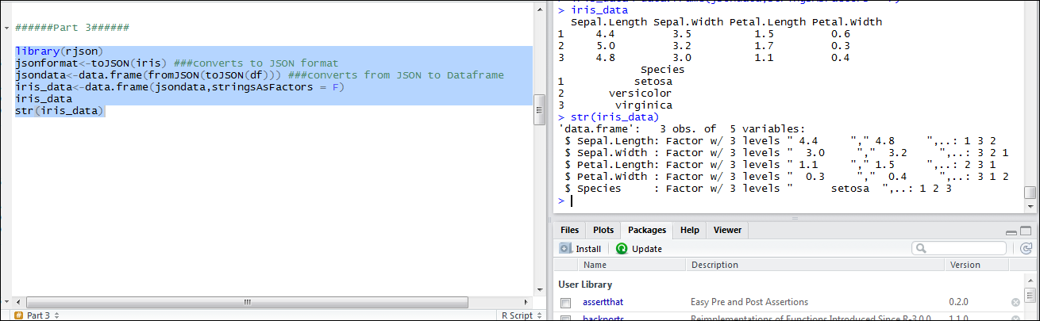
Screenshot for the solution

Slide 11
Part 4:
Use dplyr function on the data iris_data. Implement select, match, filter, arrange, rename
And mutate function on the iris_data.
Dataset
Iris_data from Part 3
Implement Select Function on the iris_data
Solution
Using dplyr for select

Slide 12
Source code
Source code with comments are given below:
iris_data
select(iris_data,3) #selects only the 3rd column of iris_data dataframe
select(iris_data,c(Sepal.Length,Petal.Width)) #selects the concatenation of(sepallength and petal width) iris_data dataframe
select(iris_data,contains(".")) #selects only those colums which has . of iris_data dataframe
select(iris_data,ends_with("Length")) #selects only those colums which ends with length of iris_data dataframe

Slide 13
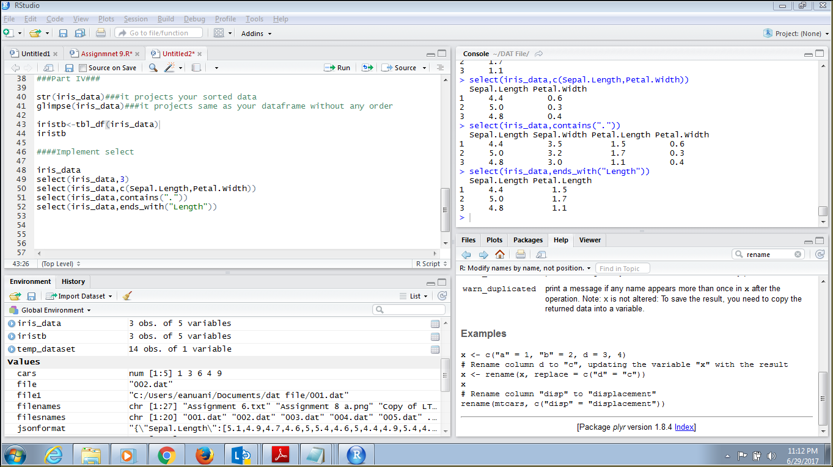
Screenshot for the solution

Slide 14
Implement Match Function on the iris_data
Solution
Using dplyr for match
Source code
Source code with comments are given below:
select(iris_data,matches("Length")) #selects only those column which matches length of iris_data dataframe

Slide 15
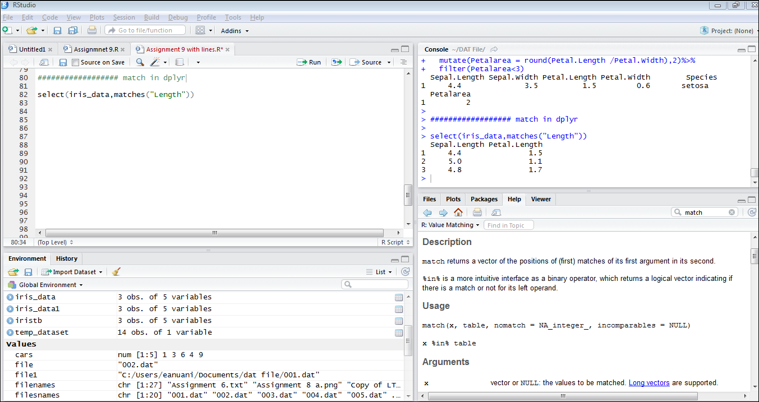
Screenshot for the solution

Slide 16
Implement filter Function on the iris_data
Solution
Using dplyr for filter
Source code
Source code with comments are given below:
library(dplyr)
filter(iris_data,Sepal.Length >4.8) #filters only the values of sepal length greater than 4.8
filter(iris_data,Sepal.Length > 4.4 & Petal.Width > 0.3) #filters only the values of sepal length greater than 4.4 and petal width greater than 0.3
iris_data$Petal.Width<-as.numeric(iris_data$Petal.Width)
iris_data$Petal.Width<-c(0.6,0.3,0.4)
str(iris_data)

Slide 17
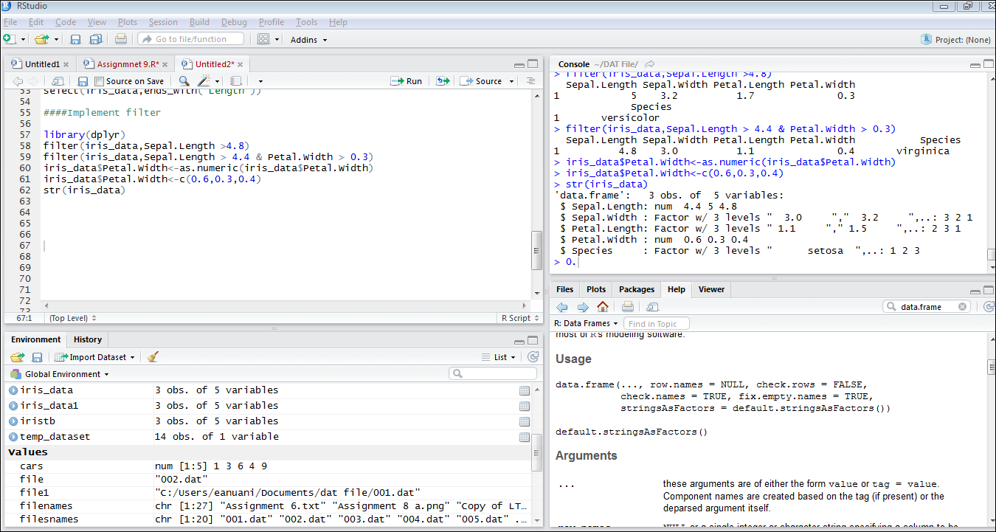
Screenshot for the solution

Slide 18
Implement Arrange Function on the iris_data
Solution
Using dplyr for arrange
Source code
Source code with comments are given below:
iris_data %>%
select(Sepal.Length:Petal.Width)%>%
arrange(desc(Petal.Width)) #it arranges the petal in descending order

Slide 19
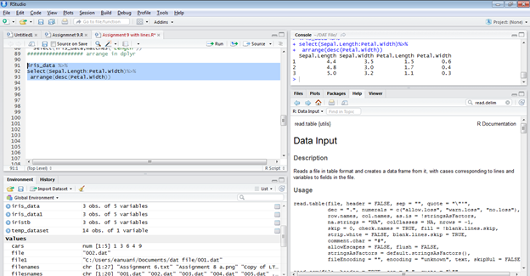
Screenshot for the solution

Slide 20
Implement Rename Function on the iris_data
Solution
Using dplyr for rename
Source code
Source code with comments are given below:
## using select
select(iris_data, Species, PetalLength = Petal.Length, PetalWidth = Petal.Width)
### using rename
rename(iris_data,c("Species"= "Speciesnew")) #renames the column name

Slide 21
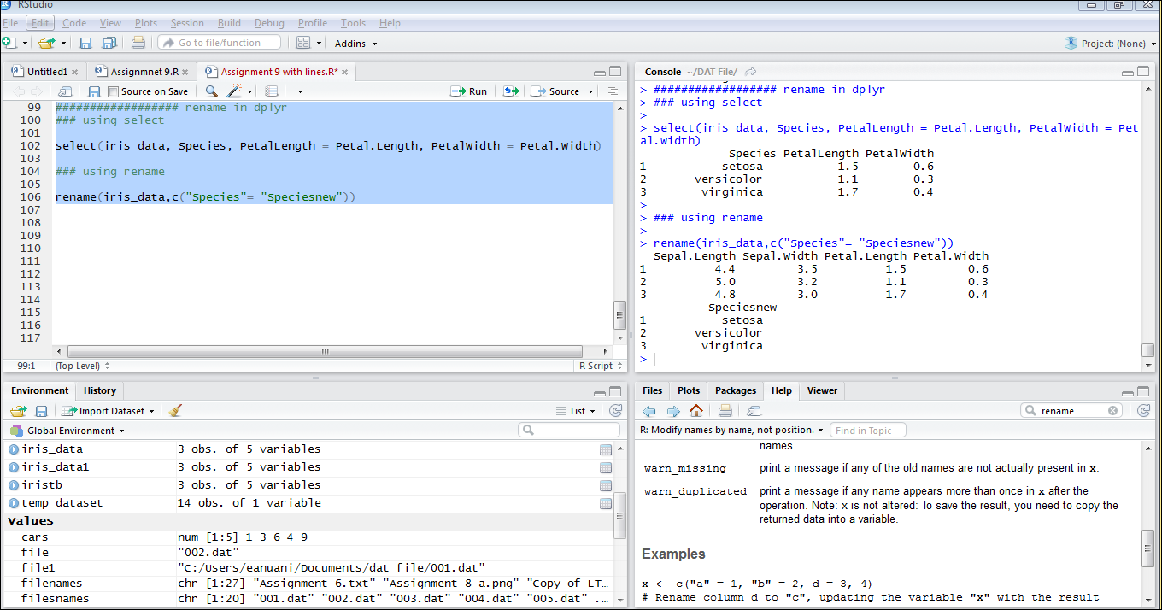
Screenshot for the solution

Slide 22
Implement Mutate Function on the iris_data
Source code
Source code with comments are given below:
iris_data$Petal.Width<-as.numeric(iris_data$Petal.Width)
iris_data$Petal.Width<-c(0.6,0.3,0.4)
iris_data$Sepal.Width<-as.numeric(iris_data$Sepal.Width)
iris_data$Sepal.Width<-c(3.5,3.2,3.0)
iris_data$Petal.Length<-as.numeric(iris_data$Petal.Length)
iris_data$Petal.Length<-c(1.5,1.1,1.7)
iris_data$Sepal.Length<-as.numeric(iris_data$Sepal.Length)
iris_data$Sepal.Length<-c(4.4,5.0,4.8)
iris_data %>%
mutate(iris_data,
Sepal.Area = Sepal.Width * Sepal.Length,
Petal.Area = Petal.Width * Petal.Length,
Area.Ratio = Petal.Area / Petal.Area) #it mutates a new column sepal area, petal area and area ratio to the dataframe
str(iris_data)
iris_data %>%
mutate(Petalarea = round(Petal.Length /Petal.Width),2)%>%
filter(Petalarea<3) #it mutates a new column petal area to the dataframe and filters petal area less than 3

Slide 23
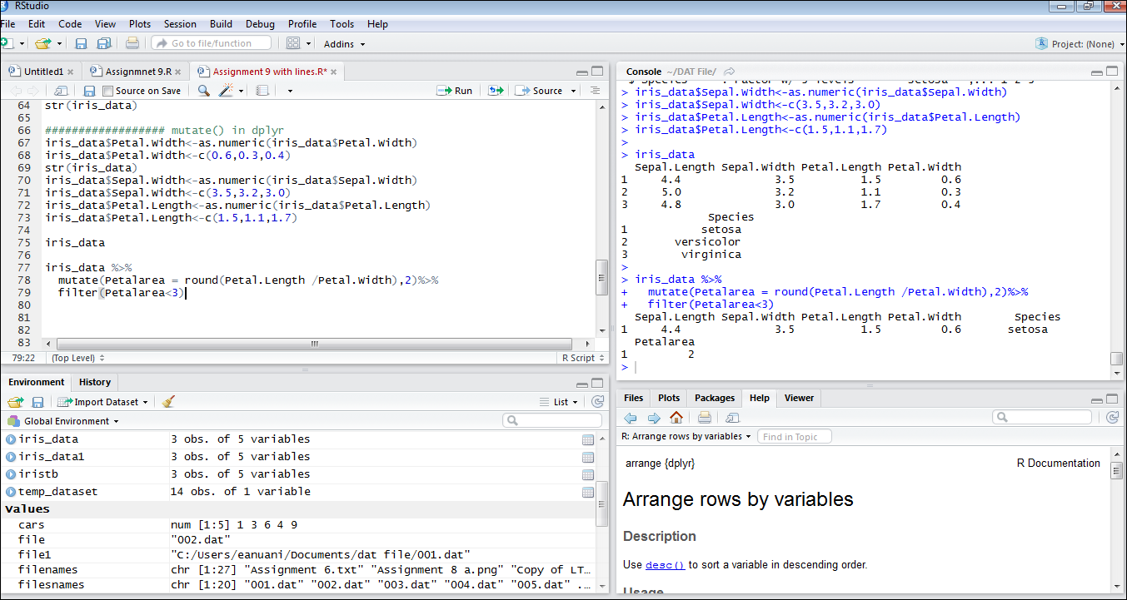
Screenshot for the solution

Slide 24
Part 5:
Print the summary of iris_data
Dataset
Iris_data from Part 3
Solution
Using summary function we can display the output

Slide 25
Source code
Source code with comments are given below:
iris_data%>%
mutate(iris_data,
Sepal.Area = Sepal.Width * Sepal.Length,
Petal.Area = Petal.Width * Petal.Length,
Area.Ratio = Petal.Area / Petal.Area)%>%
summarise(mean = mean(Sepal.Length),
sum = sum(Sepal.Area),
min = min(Petal.Area),
Mn.Md.PL = mean(Petal.Length) / median(Petal.Length),
Num.PL.Vals = n_distinct(Petal.Length)) # summarises sum, min, mn.md.pl and nu,.pl.vals values using mutate.
summary(iris_data)

Slide 26
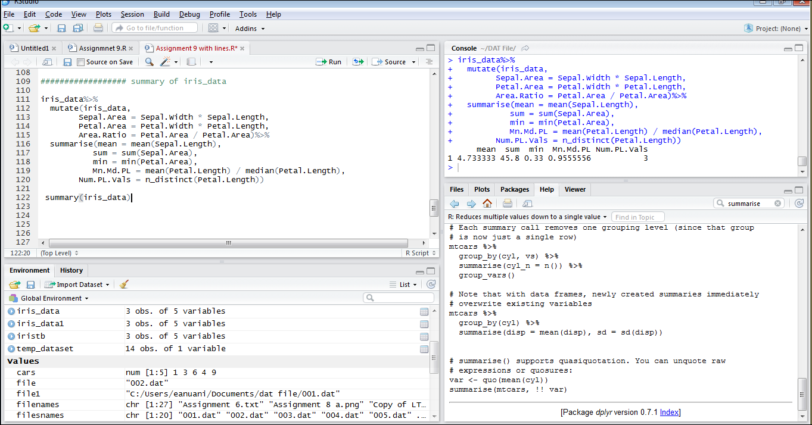
Screenshot for the solution

Slide 27
Thank You

